Slide 1

Predicting Malignancy Using Tumor Characteristics: A study of Breast Cancer
Jennifer Ruiz
DSC 680

Slide 2
A look ahead
Understanding Breast Cancer Detection
Project Scope
Methodology
Exploratory Analysis
Model Building and Prediction
Outcomes

Slide 3
Breast Cancer Detection
Detection usually occurs through development of a mass within the tissue
Examining these tumors leads to positive diagnosis
Understanding characteristics of malignancy is cornerstone of tumor research

Slide 4
Scope of the Project
This project will focus on four key areas:
What impact do size, texture, and compactness have in predicting breast cancer?
What factors lead to highest rates of malignancy?
What factors most contribute to a benign diagnosis?
What combination of factors are best for predicting malignancy.?

Slide 5
Project Approach
Extensive Data Exploration
Data Visualization for trend identification
Three Methods for Prediction:
Random Forest Model
PCA with Random Forest
Gradient Boosting Machine

Slide 6

Exploratory Analysis

Slide 7
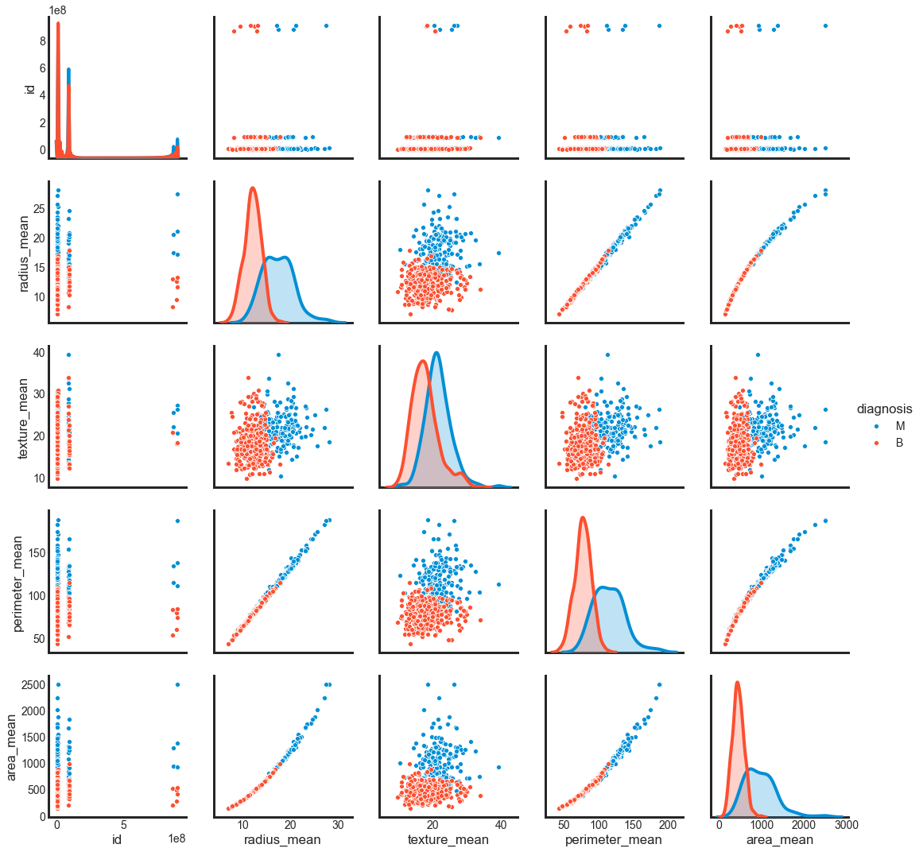
Key Findings

Slide 8
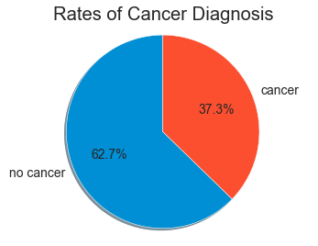
Key Findings
Majority of data points represent non-cancerous findings

Slide 9
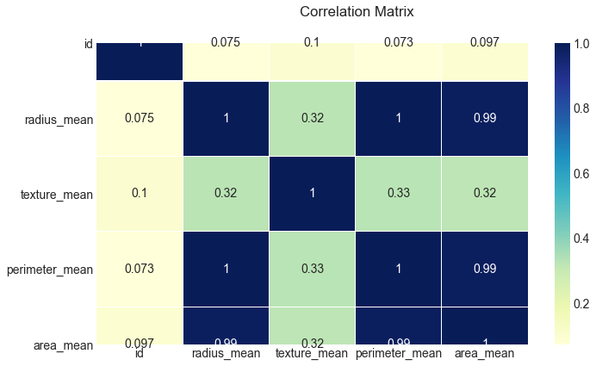
Key Findings
Features identified here may have greatest impact on malignancy diagnosis

Slide 10

Modeling

Slide 11
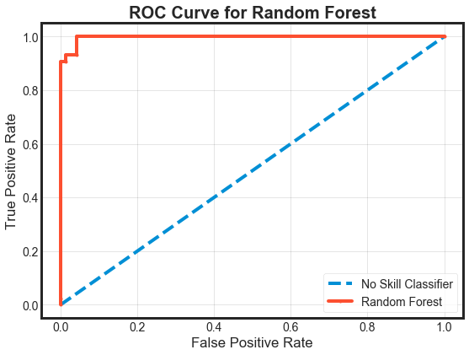
Random Forest Model
Model Achieved 97.56% Accuracy
93.02% Recall Rate

Slide 12
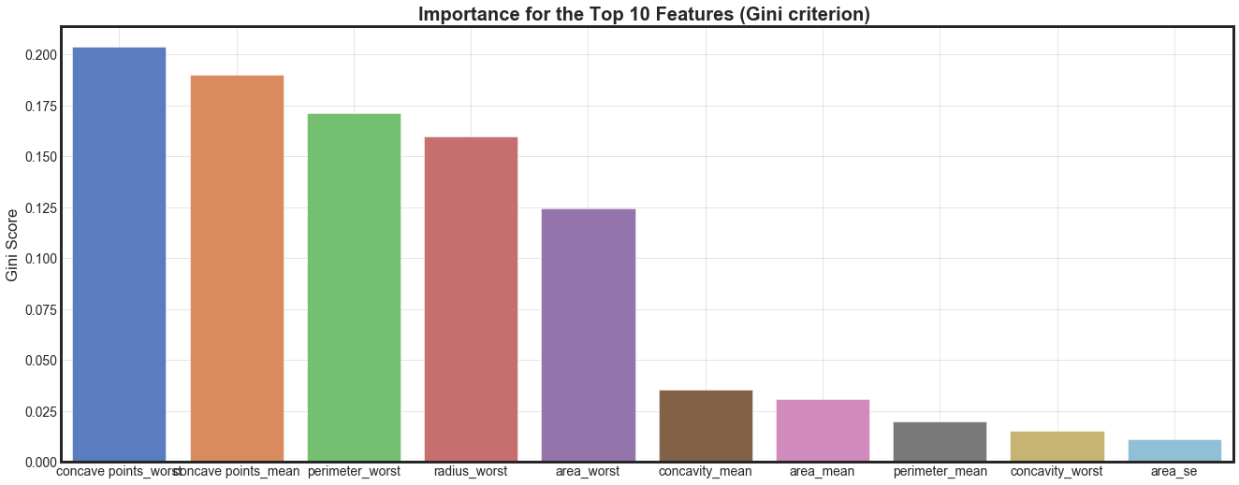
Applying Feature Decomposition to Model
Goal was to improve model accuracy by choosing features with highest predictive power

Slide 13

Random Forest with PCA
Model produced accuracy of 97.62%
Recall of 95.35%
PCA improved accuracy and recall rate for model

Slide 14
Gradient Boosting Machine
Goal was to compare PCA + RF model results to algorithm with similar predictive power
Model achieved 97.37% accuracy
These results were similar to PCA Model

Slide 15
Outcomes
All three models achieved at least 97% accuracy and above 90% recall.
PCA + RF achieved best accuracy and recall rate; allowing for faster malignancy detection based on 10 key features

